Slide 1
Student FreeLancing Portal
Group Members:
Aakash Shukla (S20160010001)
Pradeep Turan (S20160010064)
Sagar (S20160010075)
Sarin Nikose (S20160010083)
Shubham Gupta (S20160010088)
Ashish Kumar Patel (S20160020111)

Slide 2
Project Inspiration
Our project is to introduce a kind of Freelancing Portal in our college. Most of the student in pre-final/final/MS/Phd have a ton of project ideas(which they market or are researching in),but it is waste of time for them to go and develop each and every part of the system, as they have bigger problems to deal with.
advantages of using this portal:
employers can hire interested students
help students find new projects (skill-based)
flexible hours
no workplace restrictions
Finally both parties get benefited, the hirer would have more time to focus on more important things and the freelancing student would get the experience and credit of work.

Slide 3
Tables
User (userID,name,password,email,phone.no,batchYear,gender)
Skill (skillID,skill_name)
UsersSkill (userID, skillID,proficiency_value)
Communication_Language (LanguageID,Language_Name)
User_Communication_Language (userID, LanguageID, Fluency_value)
Project(ProjectID,Project_Name,Description,leader(userID),,isCompleted, postedOn, Deadline,task_count)
User_Rating (ProjectID, TaskID, RatingBy, RatingTo , rating)
Task( ProjectID,TaskID,Task_name, TaskDescription,credits, isCompleted, addedOn, Deadline)
Contributor(TaskID, UserID,isCreditVerified, timestamp)
Applicant (TaskID, UserID, timestamp)
Task_Skills_Required(TaskID,SkillID,Proficiency_value)
Hours_Of_Work (TaskID, userID, startTime, endTime, date)
Task_Rating (TaskID, UserID, Rating)
Notification (userID, _from, _to, message, hasRead, receivingTime)

Slide 4
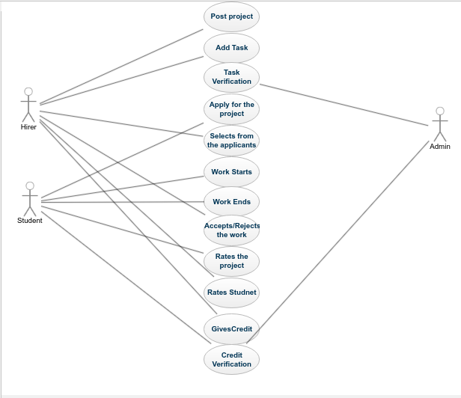
U
s
e
C
a
s
e
Post project and work credit
Required Skills
Employer
Apply for project
selection of students
Notified about selection
Work starts
Completion of project
Student
Ends project
Rates students
Rates hirer and project
Gives credit and certifies
Credit Verification

Slide 5
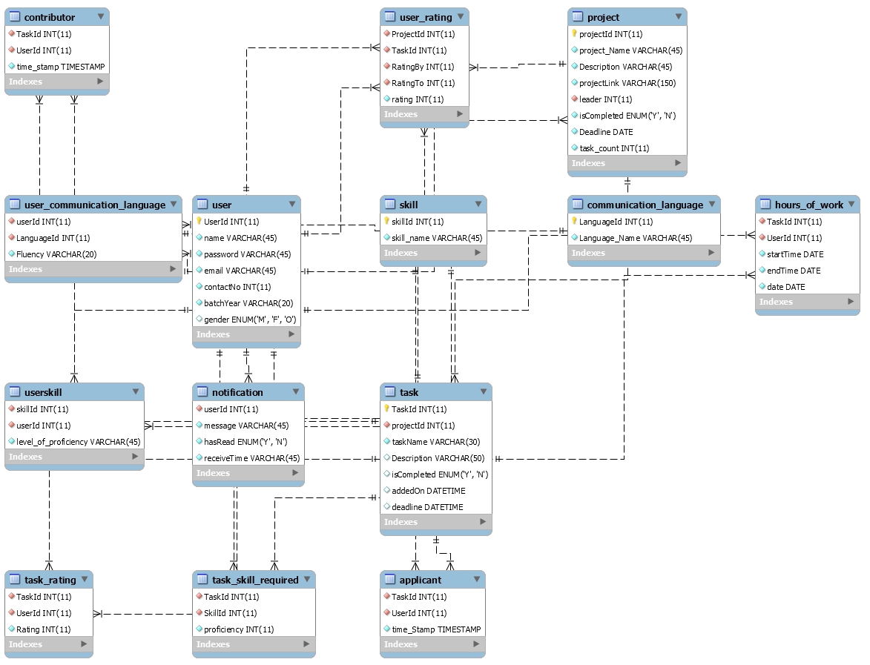

Slide 6
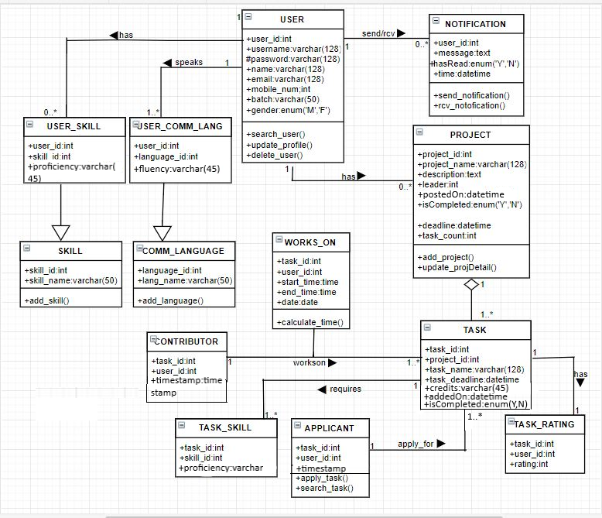
Class Diagram

Slide 7
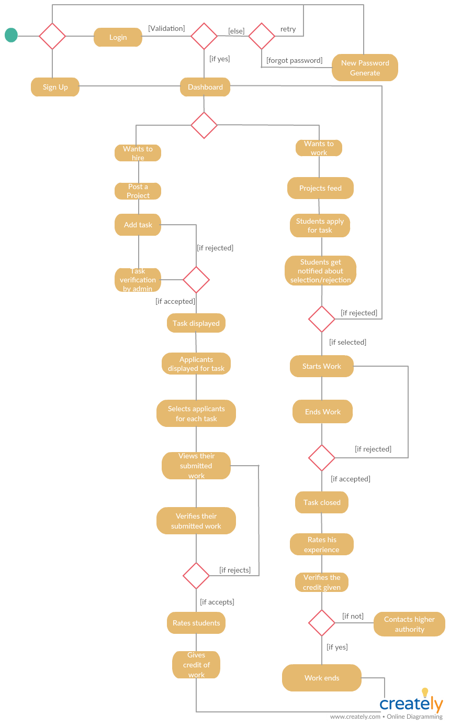
A
c
t
i
v
i
t
y
D
i
a
g
r
a
m

Slide 8
Risks
Lack of skills
Lack of Responsibility
Mid-Sem Exam
Software Crashing
Issues within team

Slide 9
Thank You

